Slide 1
Stock Price Movement Prediction Using NYSE Dataset
Presented by:
(Group 9)
SATYA TEJ KAMMILI (satyatejkammili@my.unt.edu) 11911161
MERLA GANESH REDDY (merlaganeshreddy@my.unt.edu) 11797294
RUTHVIKA MUCHALA (ruthvikamuchala@my.unt.edu) 11906895
KOUSHIK REDDY SUDIREDDY (koushikreddysudireddy@my.unt.edu) 11885863

Slide 2
Project Overview
Purpose:
Predict next-day Up/Down for NYSE (2010–2016)
Scope:
Full ML pipeline: Data → Features → Models → Evaluation.
Models:
Logistic Regression, Random Forest, XGBoost
Tools:
Python • Pandas • scikit-learn • XGBoost • Google Colab

Slide 3
Problem Statement & Objectives
Problem:
Short-term market direction is noisy.
Objectives:
Feature design
Compare linear vs non-linear.
Evaluate with Accuracy/F1/ROC-AUC.

Slide 4
Data Description
Dataset:
NYSE daily OHLCV (2010–2016)
Files:
Securities.csv
Prices-split-adjusted.csv
Fundamentals.csv
Sample Size: 841 k records • 501 tickers and target ~52% Up

Slide 5
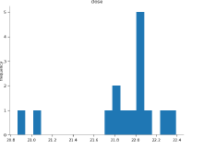
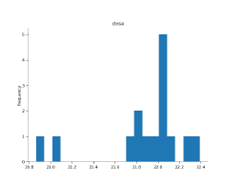
Feature Engineering
Feature Groups:
Momentum: Lag returns (1d, 3d, 5d, 10d)
Volatility: Rolling mean & std (5–20 days)
Volume: % change + rolling averages
Technical Indicators: RSI • MACD • Bollinger Bands
Calendar: Day of Week • Month • Quarter
RSI plot
Bollinger Band

Slide 6
Model Development
.
Model | Description | Notes
Logistic Regression | Linear baseline | Interpretable, simple
Random Forest | Bagged trees | Handles non-linearity
XGBoost | Boosted trees | Highest accuracy
Data
Preprocessing
Feature Engineering
Model Training
Results

Slide 7
Model Evaluation
Metric | Logistic Regression | Random Forest | XGBoost
Accuracy | 0.512 | 0.508 | 0.517
F1-score | 0.511 | 0.508 | 0.514
ROC-AUC | 0.513 | 0.519 | 0.521

Slide 8
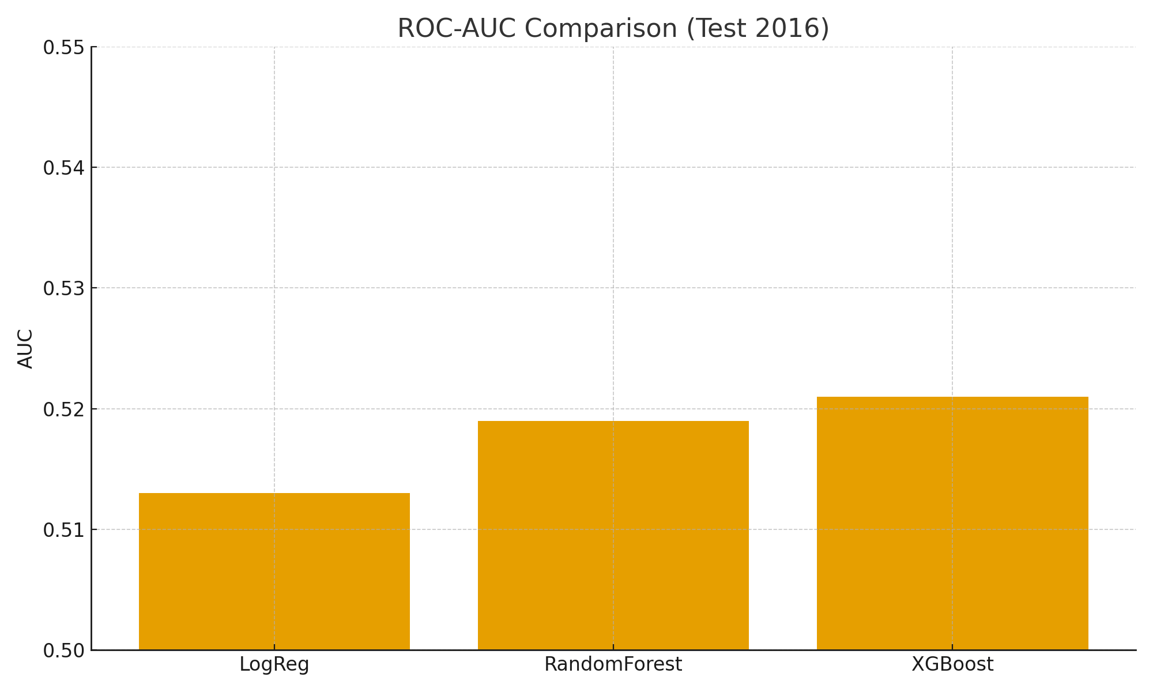
ROC-AUC Comparison
XGBoost highest AUC (0.521)

Slide 9
Discussion & Insights
Findings:
AUC 0.51–0.52 → slightly above random (expected).
XGBoost best → captures subtle non-linear patterns.
RSI + Volume + Bollinger strongest combined signals.
Small edge can matter at portfolio scale.

Slide 10
Limitations & Future Work
Limitations:
Daily data only; no macro/news/sentiment; no intraday.
Future: LSTM/Transformers, SHAP explainability, backtesting, sentiment & macro features.

Slide 11
Conclusion
Reproducible end-to-end pipeline built.
XGBoost best (AUC ≈ 0.521).
Markets are noisy; weak but usable signals exist.

Slide 12

Thank You
Git-hub 💻💻
https://github.com/VirtualHost101/SatyaTej-StockPredictorProject.git

